Slide 1
Massively Open Online Courses (a.k.a. MOOCs)
Charles Severance
University of Michigan
School of Information

Slide 2
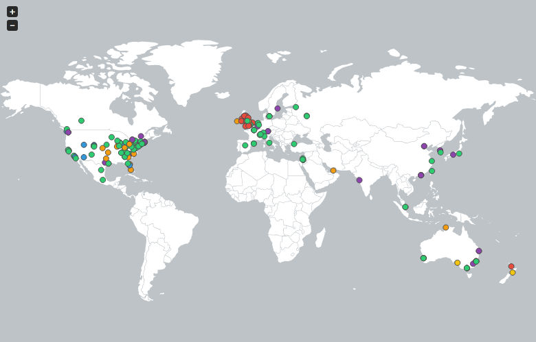
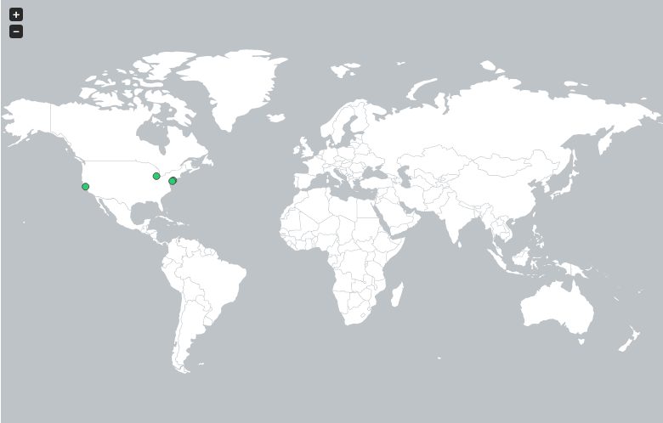

http://edutechnica.com/moocmap/
October 2013
Notes:
There are many other providers of MOOC courses such as the EdX consortium led by MIT and Harvard. There are well over 100 universities around the world providing free and open versions of their courses. There is an ever-growing list of exciting free courses available from universities around the world.

Slide 3
www.coursera.org
Notes:
If you look at the leading provider of free open courses – Coursera – among their 450+ courses you will find a free course that I teach for the University of Michigan titled, “Internet History, Technology, and Security”.

Slide 4
http://edutechnica.com/moocmap/
April 2012
Notes:
But let me take you back 18 short months when there was only one provider of MOOCs with only four Universities (University of Pennsylvania, Stanford, Michigan, and Princeton). It was just an experiment in early 2012 and I was fortunate to even know about the emerging effort – let alone be given a chance to teach this new type of course for the University of Michigan.

Slide 5
Internet: TCI
Nuthin’ But Net
Notes:
They said I could teach any course I liked. I am a trained Computer Scientist, but most of the first courses were already about programming and Computer Science and I decided to do something different. I decided and teach a course on the History of the Internet using video interviews that I had gathered when I was part of a nationally broadcast television program in 1995 about the Internet. My co-host Richard Wiggins and I produced the first nationally televised program about the Internet....

Slide 6
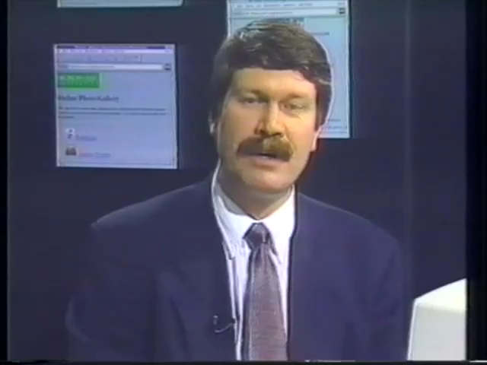
Taped in 1995

Slide 7
Notes:
My historical materials from the 1990’s and more recent interviews form the basis for my Coursera course on Internet History, Technology, and Security. I am now in the middle of teaching the course for the fourth time in 18 months on Coursera. Over 10,000 students have completed my 11-week class and earned a certificate.

Slide 8
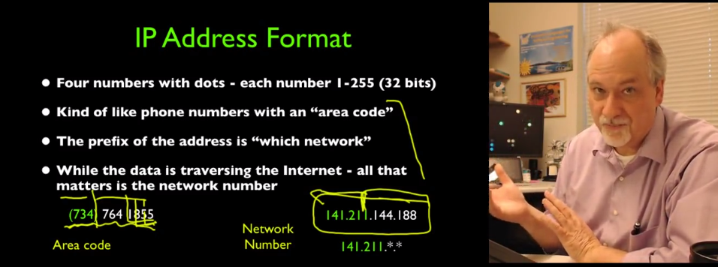
Notes:
Then in the class we move to how the current Internet actually works. I don’t teach to any deep detail – just enough to get a sense of how things work and hopefully spur my students to be curious to learn more.

Slide 9
N=4701
http://www.dr-chuck.com/coursera/insidetheinternet/2012-001/maps/where.html
Notes:
This is location data from a demographic survey in the first section of IHTS. Coverage of all major continents and countries.

Slide 10
New York, Los Angeles, Ann Arbor, Chicago, Washington DC, Memphis, Seattle, Seoul, Barcelona, London, Mexico City, Amsterdam, Manila Melbourne, Perth...
http://youtu.be/GD9RSoVDKkw
Notes:
Since I have a very active travel schedule, I decided to hold office hours in the major cities I have visited in the past 18 months. I have held office hours in over 15 cities and in each location somewhere between two and 15 students show up.

Slide 11
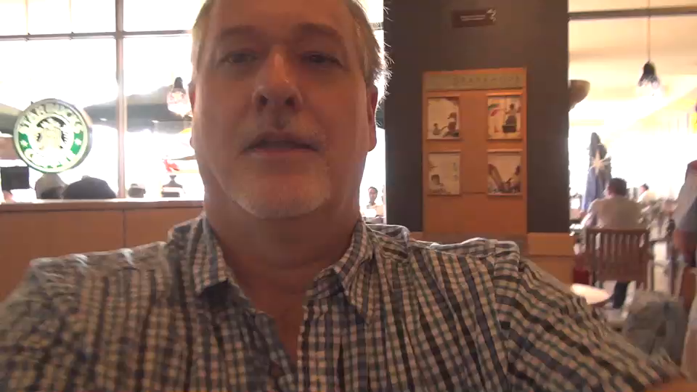

Slide 12
Megan (UK)
Karen (NC)
Mazen (Egypt)
Sue (CA)
Susan (PA)
Mauro (Italy)

Slide 13
Mauro (Italy)
Notes:
Really – if we want to educated the world – we must use MOOCs as a breeder reactor to for, train, and support new teachers.

Slide 14
Across four sessions:
Start Class: 31343
Finish Class: 12804 (41%)
Enrollment: 139375
Attend One Lecture: 53958
Notes:
Here are the large numbers. Over that same period I have taught 300 students in face-to-face courses at the University of Michigan. And my classes are some of the largest in the School of Information at UM. In the past 18 months 40 times more students have completed my online class than have completed my face-to-face class. It is a lot of fun to touch so many lives.

Slide 15
Five Million Students / 54 Staff
Notes:
When you have five million students and someone is producing material for free. When you have 70 students.

Slide 16
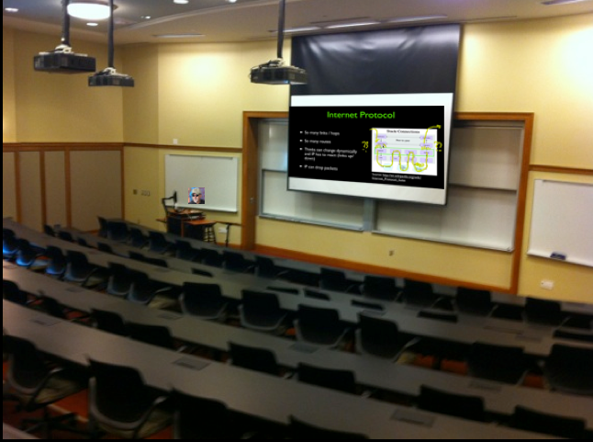
Is this new?
Notes:
We had classes on televisionin the 1960’s. I taught my first online class with streaming audio in 1996. What is different?

Slide 17

http://www.flickr.com/photos/aussiegall/286709039 (Creative Commons)
Notes:
Is this about measuring or learning? Is this different?

Slide 18
http://mfeldstein.com/emerging-student-patterns-in-moocs-a-revised-graphical-view/
Notes:
Shows student deciding what and how to learn. Is this what “student centered” learning looks like? By the third week they are serious For me over 40% present at the end of week 1 finish the class.

Slide 19
How to train children.
http://en.wikipedia.org/wiki/B._F._Skinner
Notes:
Skinner box – “operant conditioning” – positive and negative reinforcement. In education, Skinner suggests that any age-appropriate skill can be taught.

Slide 20

http://www.flickr.com/photos/87913776@N00/5130228454 (Creative Commons)
Notes:
A lot of people thing this is the instant end of higher education....

Slide 21
What will change?
http://www.insidehighered.com/news/2013/05/14/georgia-tech-and-udacity-roll-out-massive-new-low-cost-degree-program

Slide 22
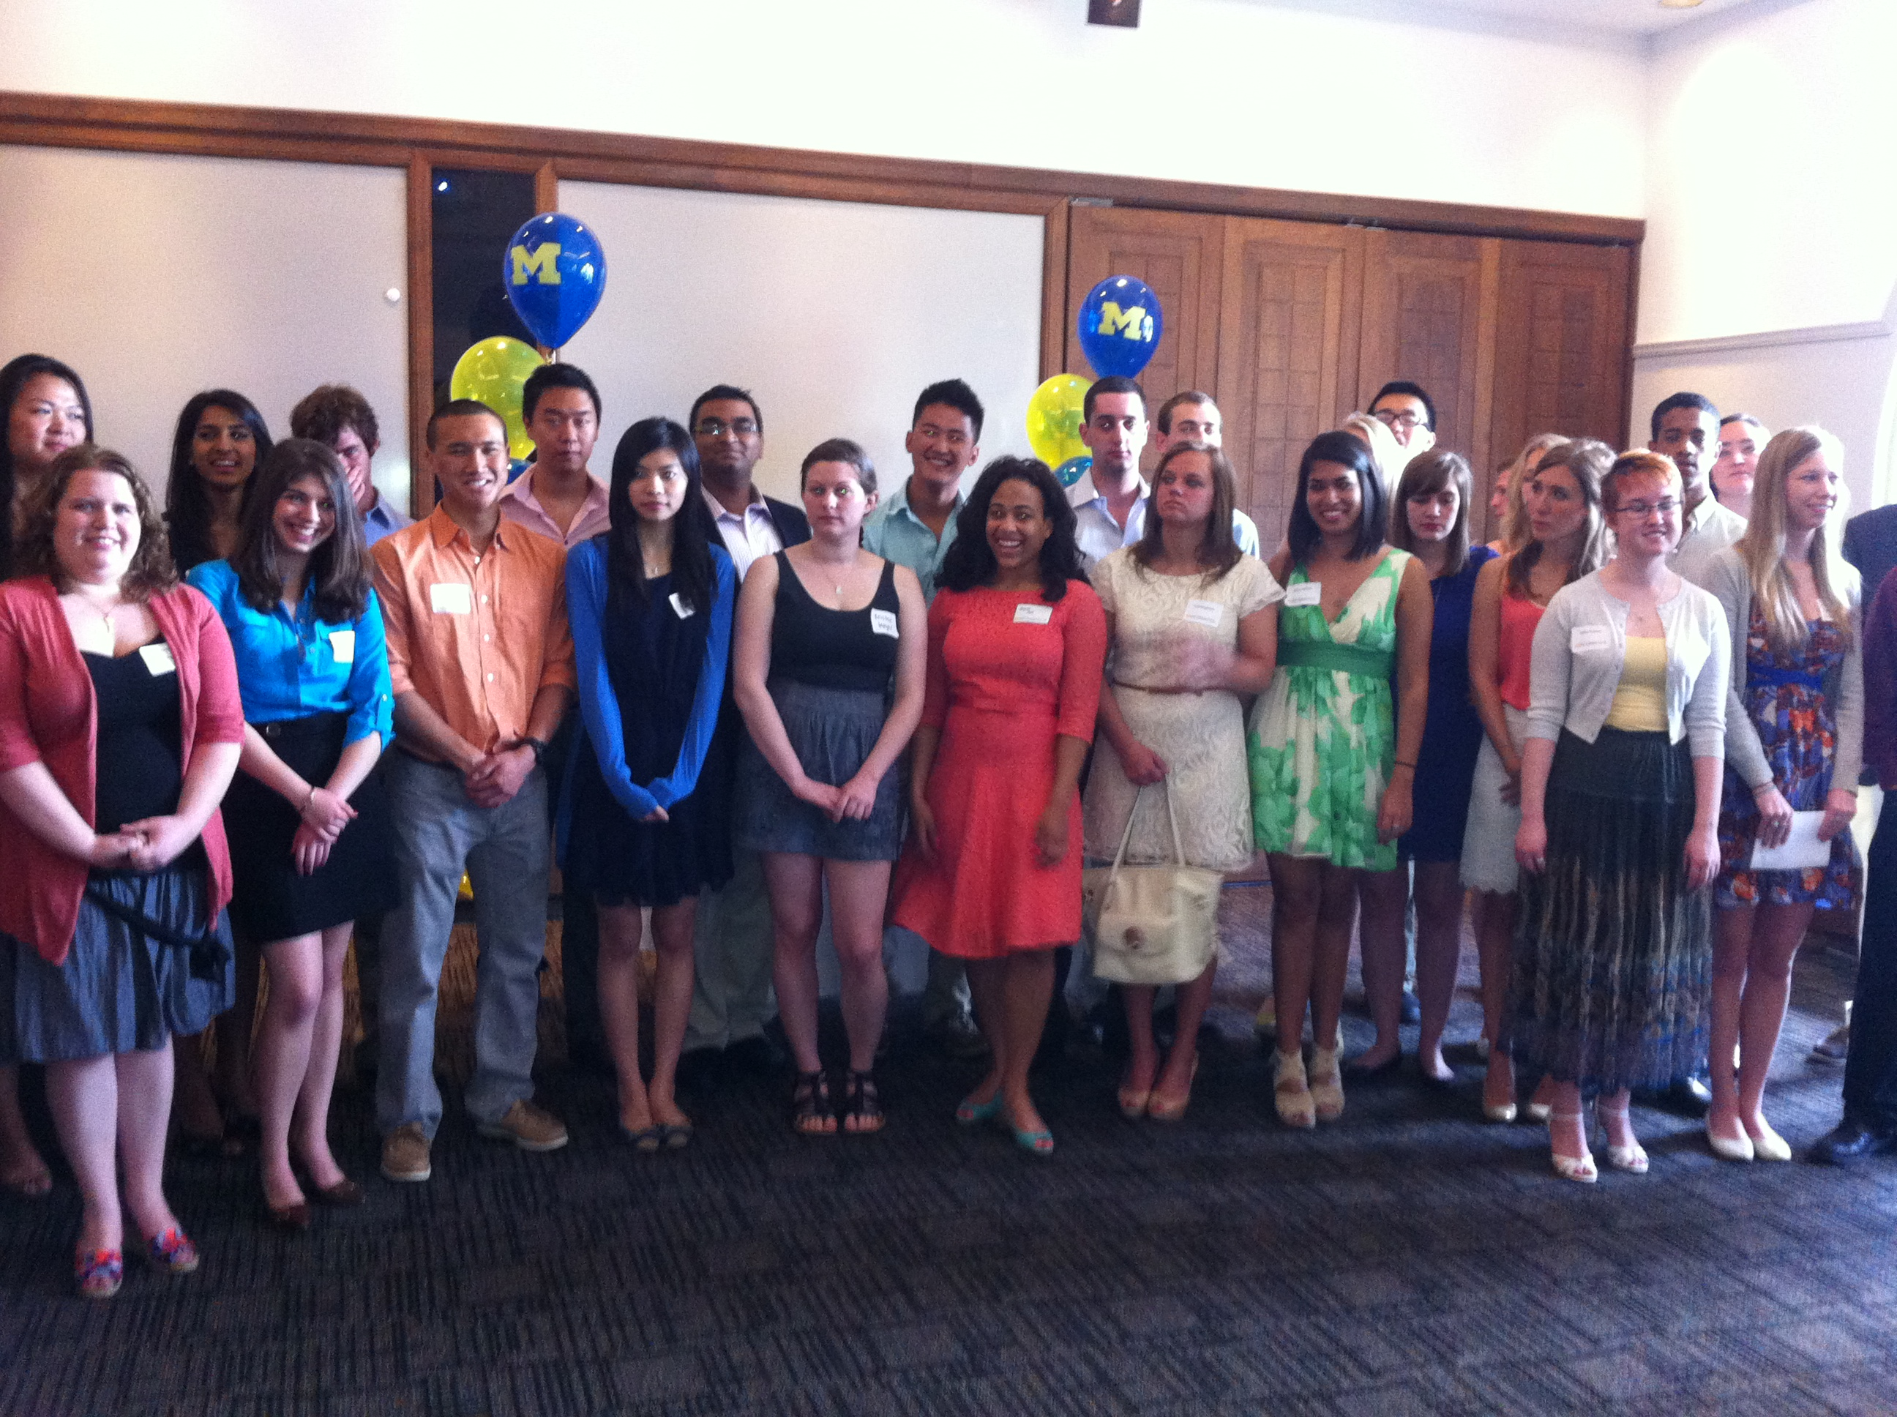
University of Michigan Informatics Graduation Reception – April 2013
Notes:
How will this improve face-to-face education. This is my “product”. This is what pays my salary.

Slide 23
http://edutechnica.com/moocmap/
This is only after 18 months...

